Slide 1
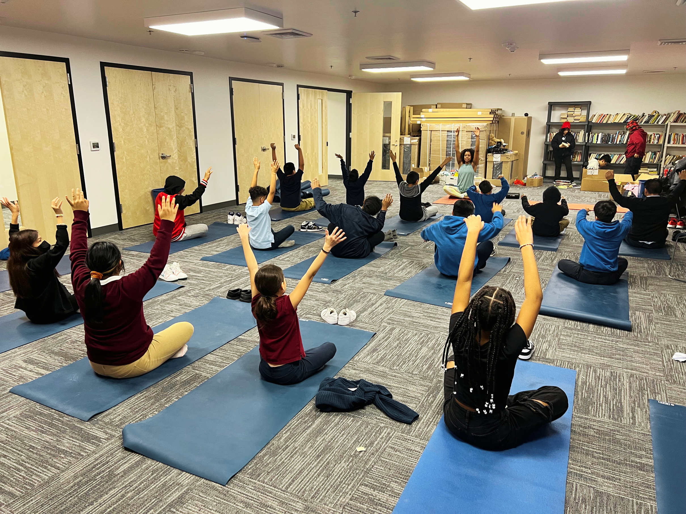

STRIVING FOR WELLNESS EQUITY
Developing and Implementing a Wellness Education Program for Children and Families in Underserved Communities
Dejenaba Gordon, MPH
Lisa Squires, RN
Robin Miccio, MS
Winona Chua, MD
Maria Mascarenhas, MBBS
Notes:
Lisa

Slide 2

MINDFUL MOMENT
Notes:
Lisa

Slide 3
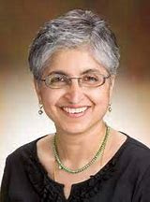
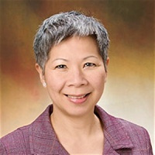
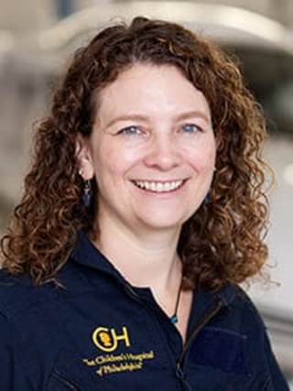

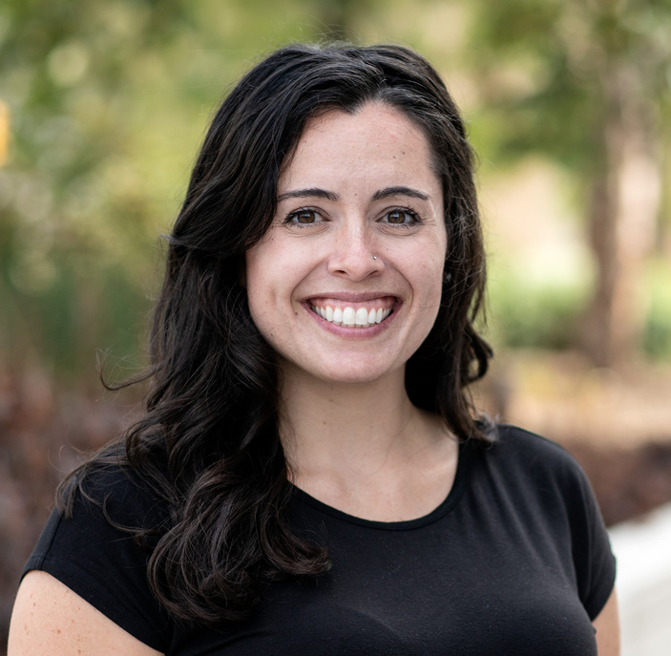
PRESENTERS
Dr. Maria Mascarenhas
Dr. Winona Chua
Lisa Squires, RN
Dejenaba Gordon, MPH
Robin Miccio, MS
Notes:
Lisa
Should you mention that we all have expertise in different wellness practices

Slide 4

LEARNING OBJECTIVES
In this session, participants will be able to:
  Share potentially new wellness tools or skills with their patients and community
  List successful processes they can adopt and what pitfalls to avoid in the development and implementation of a community-based wellness program
  Understand the outcomes of interest for community-based wellness education
Notes:
Maria

Slide 5
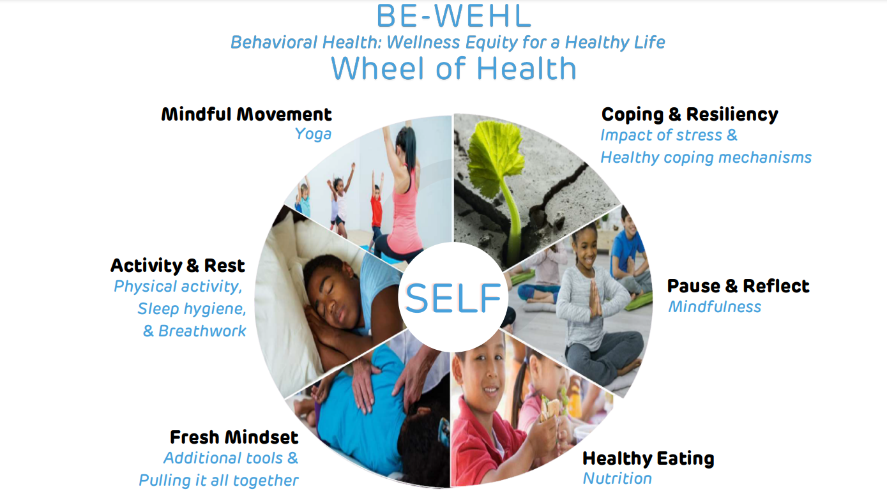
Notes:
Maria

Slide 6




PROGRAM DEVELOPMENT
1.0 BE-WEHL in
Homes
  Virtual synchronous classes
  Wellness Educator & family
  Referrals from PCP, Behavioral Health for children with mild-moderate anxiety, depression, ADHD, Autism, and/or ODD
2020-2022
2.0 BE-WEHL in Communities
  In person classes K-12 Classrooms, After School Programs
2022-2024
3.0 BE-WEHL Thriving Classrooms for Early Childhood Educators & Children
  In-person workshops for teachers
2024-present
Notes:
Maria

Slide 7



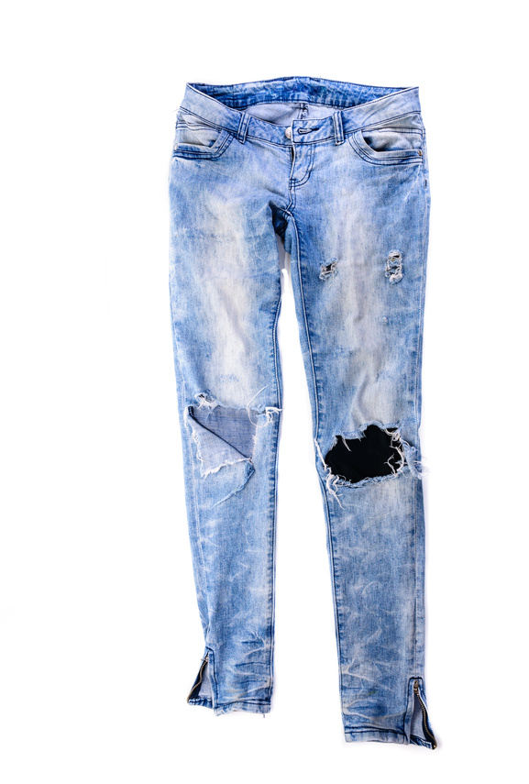
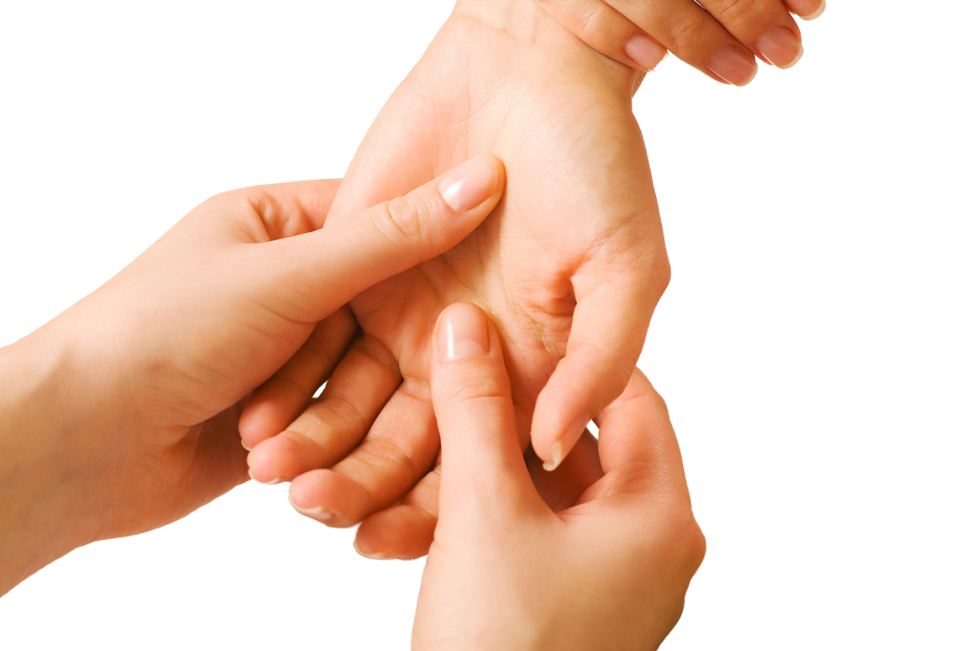

PROGRAM DEVELOPMENT
Curriculum development lessons from a family advisory council (FAC), literature review, & experts.
Invitations & Recommendations
  Exposure at a young age matters
  Images used should be representative of community
Hire from the community
Creative ways to increase access, for example tug-of-war activity with an old pair of jeans
  Content Literacy Accessible
  Culturally Competent & Trauma-informed
Thoughtfulness in Naming Classes, for example Caring Touch “Caregiver & Child Massage”
Notes:
Robin

Slide 8
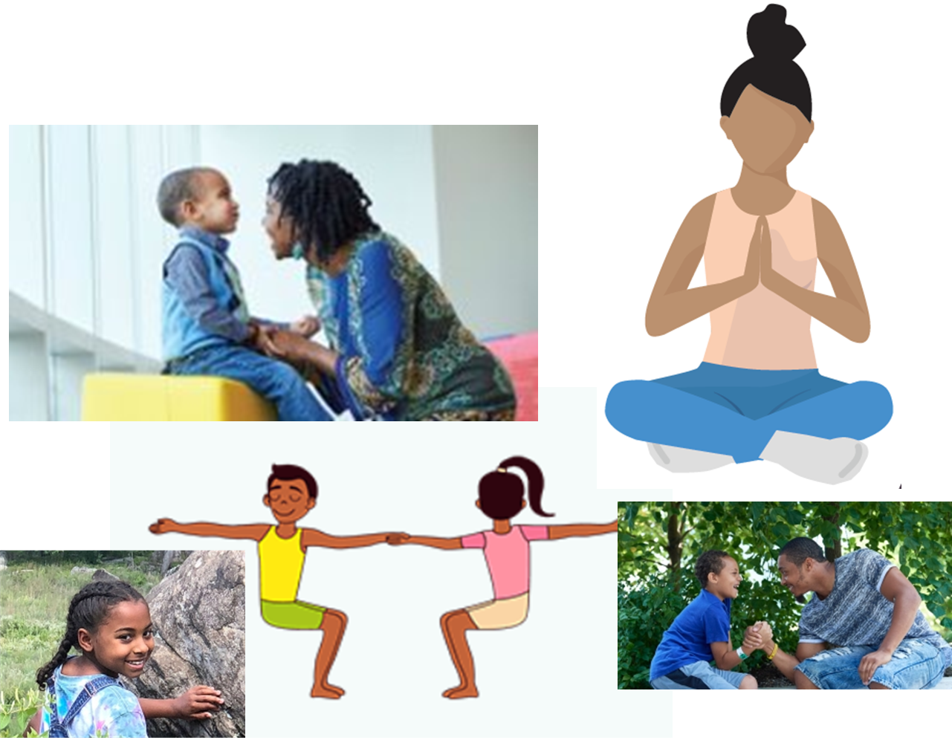
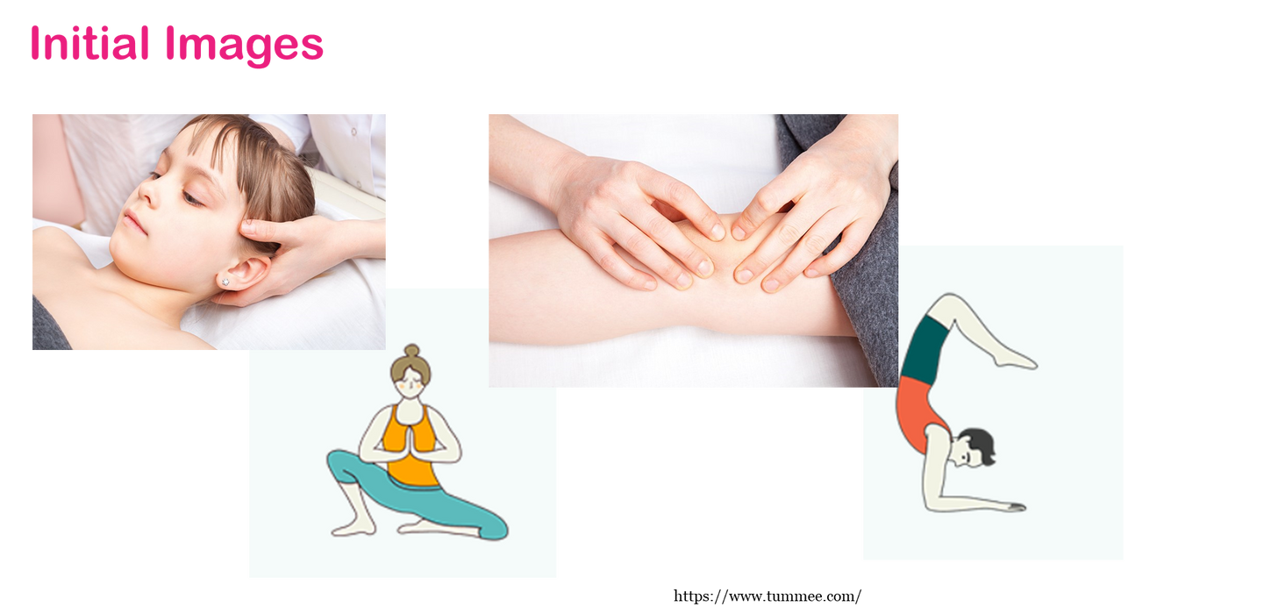
PROGRAM DEVELOPMENT
Image Evolution
Notes:
Robin

Slide 9







PROGRAM DEVELOPMENT
BE-WEHL in Homes: Wellness Kit Materials
Affirmation cards, Gratitude journal
Coconut oil
resiliency & coping
caring touch
Jump rope, Basketball, Aromatherapy sniffers
Kid-friendly knife, cutting board, Anti- Inflammatory Cookbook, Food ingredients delivered to home
activity & rest
healthy eating
Feudtner Coping
Kit for Parents,
Mindfulness and
related books
Yoga mat,
Fitness tracker
pause & reflect
mindful movement
Notes:
Robin

Slide 10
IMPLEMENTATION
Health & Wellness Educator (HWE) Recruitment & Training
Recruitment of Health & Wellness Educator:
  Community Health Worker model, role called Health & Wellness Educator (HWE)
  HWE should represent population served
  Selected candidates who had a wellness and health education/ community background: massage, yoga, wellness coaching
HWE Training Process:
  HWE studies curriculum
  HWE experiences curriculum as student in one-on one sessions with another HWE
  HWE shadows session with experienced HWE
  HWE presents classes to project team for feedback
  HWE teaches series while being observed
  Weekly meetings with project team to address any concerns and problem solve
Notes:
Dejenaba
o How we recruited our teachers: tiffany, Dejenaba, Keanna – training process and fidelity. Project started without funding, so we used in-house staff. Then when we got more funding, we were able to hire from community.
All HWEs had advanced degrees in this role - may have contributed to the success of this model
Clinicians volunteering time. Development Team: Clinicians created curriculum with limited funding, in-kind support.
Project team: there are clinicians, managers who were not paid on this project and provided in-kind support.

Slide 11
IMPLEMENTATION
Lessons learned from delivering classes
1.0 BE-WEHL in Homes - Virtual Family Classes 1:1
Referrals for Behavioral Health Challenges
  Family-based program is successful; encourage family engagement at onset
  Learn from families - build off of what they enjoy
  Include all family members, create a safe/brave space
  Honor and acknowledge practice roots
  Massage class worked better with families than in subsequent iterations
  Training caregivers as trainers not feasible in this project
Notes:
Dejenaba
Mention Tiffany’s Shrimp fried rice recipe because family would not eat salad
Permission slip for parents - yoga classes
FLEXIBILITY with each community/population is critical. Each iteration had its unique challenges for scheduling. Parents doing sessions in their cars. Schools had to reschedule. Early Childcare Centers difficult due to how their day is structured.
Explain through the last bullet - 3 families interested, 1 trained, etc. We opened it up to caregivers to apply for job once posted.

Slide 12
IMPLEMENTATION
Lessons learned from delivering classes
2.0 BE-WEHL in Communities - K-12 Classrooms, After School Programs
  Connect through shared lived experience and/or draw from students’ experiences
  Different activities are appealing to different age groups, give them a choice - permission to abstain from practice
  Be sensitive to religious and cultural dynamics
  Research study was difficult to implement in schools
  Concurrent virtual parent classes not well attended
  More success scheduling classes with city charter schools and suburb schools than city public schools
  Mindfulness practices were embedded into school structure in more affluent areas as compared to less affluent areas
  Massage class:
    Changed title from “Caring Touch” to “Healing Hands” and covered consent to touch. Schools were uncomfortable with the idea of touch
    High school - removed massage class and replaced with “Fresh Mindset” class
  Yoga- sometimes perceived as a spiritual practice that conflicted with religious beliefs
  Take into consideration the limited nature exposure in city, be creative
Notes:
Dejenaba
Curriculum was received differently in affluent areas because they had already been exposed and had a deeper understanding and actively practicing. It was more of a refresher/reminder that contributed to their habits.
Self-massage class: we taught elementary school kids about good touch, bad touch and consent to touch. Massgae class was developed for parent and child. Teenagers did not receive the content well and it was not as in-depth enough so Fresh Mindset expanded on massage and more wellness tools they can benefit from.
Nature - plant indoors, look out the window, recognize that kids in cities might have a fear of bushes (guns)
Kid took mindful breath before reacting - she 'responded' to another kid teasing her and did not fight

Slide 13
IMPLEMENTATION
Lessons learned from delivering classes
3.0 BE-WEHL for Early Childhood Educators (ECE)
- Training for Educators
  Build strategic relationships with community-based organizations to support recruitment and build community trust
  Previous ECE trainings typically focus on the children they teach, but there is a lack of focus on stress management & support for ECEs
  Scheduling flexibility is required because of limited time of ECEs
Notes:
Dejenaba
Talk about implementing wellness in 7 fruits of the spirit in Christian communities

Slide 14
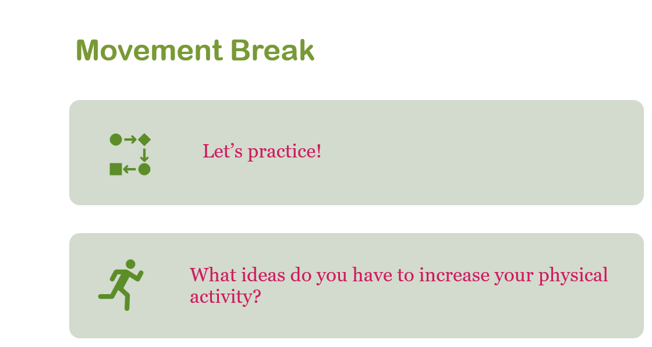
CONTENT: ACTIVITY & REST CLASS
Notes:
Dejenaba
Note - this is the slide we use in the class... o Boys always wanted to do 1000, but they ended up doing 100. Then they talk about the heart rate and how the body feels – reinforces what they see on the slides. Let’s experience this. Interoception. Incorporate that in the middle of our talk. Children needs break from lecture style, we want to introduce something you can do as a break – lightening up energy. 30 seconds. Dejenaba does a physical movement that she teaches to daycare staff (hands up, cross over, etc.)

Slide 15
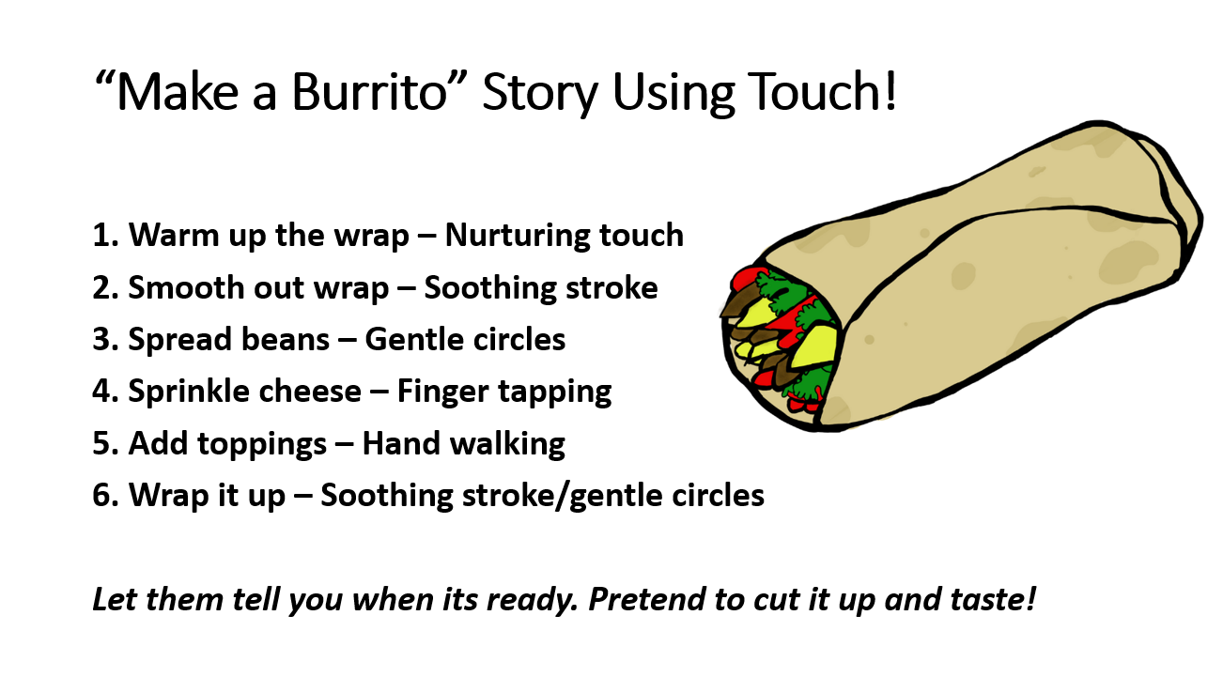
CONTENT: HEALING HANDS CLASS
Notes:
Robin

Slide 16
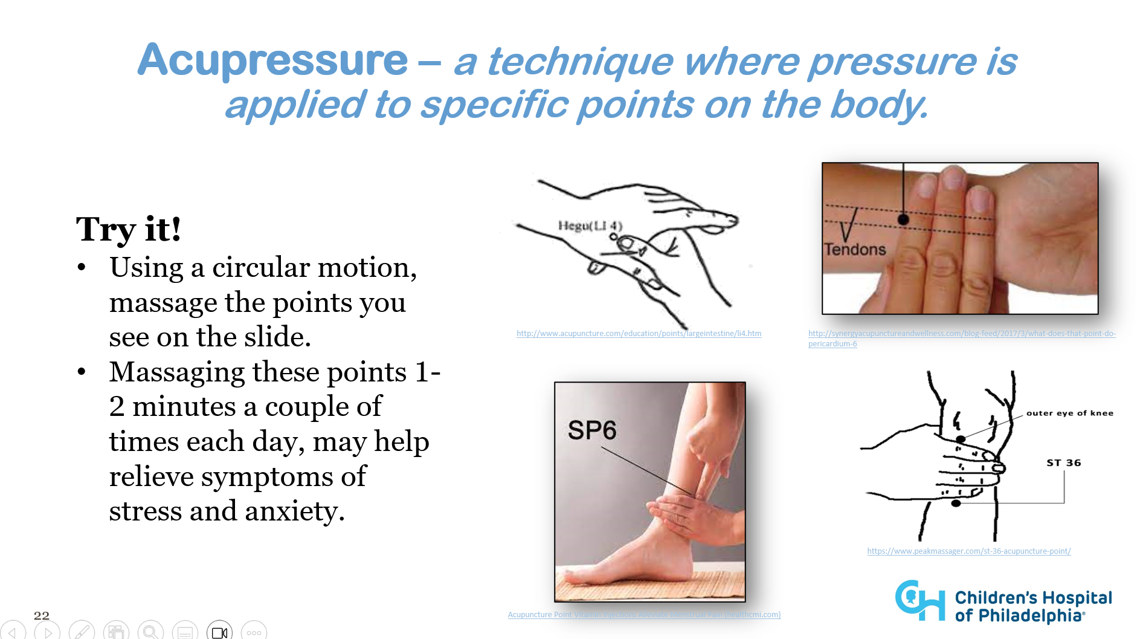
CONTENT: FRESH MINDSET CLASS
Notes:
Winona

Slide 17
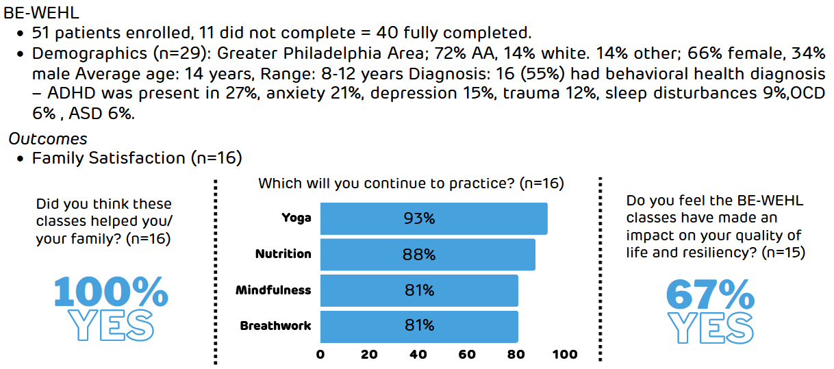
FINDINGS: FEASIBILITY & ACCEPTABILITY
40+
1.0
BE-WEHL in
Homes
FAMILIES REACHED
CHOP patients with BH challenges or diagnosis such as ADHD, ODD, Autism
Notes:
Winona

Slide 18
FINDINGS: FEASIBILITY & ACCEPTABILITY
2.0
BE-WEHL in Communities
2000+
STUDENTS, CAREGIVERS, + YOUTH PROVIDERS REACHED
Across 40 sites Camden, Philadelphia & Montgomery Counties
95%
  reported BE-WEHL helped their group and would want to participate again
  would recommend the program to other groups
  Breathwork and mindfulness were two of the most popular topics and sites reported they would continue to practice these techniques within the classroom.
  Focus group (n=5): children internalized the messages, were better able to express themselves constructively, and were actively using the tools from BE-WEHL at school.
100%
Notes:
Winona

Slide 19




FINDINGS: FEASIBILITY & ACCEPTABILITY
Quotes from Participants
1.0 BE-WEHL in
Homes
2.0 BE-WEHL in Communities
3.0 BE-WEHL in ECE
Time with my child learning new things was the most rewarding thing.
This program helped to open the conversation around mental health and well-being for our students and families.
It’s important that the childcare provider is healthy physically and mentally, BE-Well gave us the tools to help in that process.
Having the Hands-On material was very rewarding. It helped make the classes more understanding and fun 🙂
I want to thank you for the wonderful work you are doing, educating young people about how to be healthy. We’ve practiced your breathing exercises in class and for homework, and students have been showing me labels on their foods and noticing the amount of sugar and now understanding more about how food impacts their body and energy levels. Your phrase of having an “attitude of gratitude” has really stuck with me.
Children need you to be less stressed to help them be less stressed
It was rewarding to have us complete tasks together. It helps with [my child’s] anxiety.
[It was helpful to learn]... about how stress impacts every part of your life. You can find relief through one breathing and listening to your body.
Notes:
Winona
Don't need to read these, but indicate positive feedback and pause so folks can read

Slide 20
OUTCOMES OF INTEREST
BE-WEHL for Early Childhood Educators
  Pre and post implementation survey, and 3 mo. follow-up survey that measure educators’
    knowledge of wellness practices
    beliefs
    utilization for self and adapting strategies in the classroom.
  Focus groups to identify new themes and improve curriculum/implementation
Notes:
Robin

Slide 21


BE-WEHL IS EVOLVING
1.0 BE-WEHL in
Homes
2.0 BE-WEHL in Communities
3.0 BE-WEHL in ECE
BE-WEHL for CHOP’s Patient Families - Virtual Classes
  Sickle Cell Disease
  Behavioral Health for Children & Adolsecents
  Chromosome 22q11.2 Deletion Syndrome Research Study
BE-WEHL in CHOP’s Outreach Clinics
  Feeding Clinic
  Healthy Weight Clinic
  Behavioral Health
    Mood Disorders Partial Hospitalization
Notes:
Lisa
Because of our implementation in the community...other clinics wanted this for their patients for CHOP's patient community. Can be adapted in many different ways. Will continue the work in the communtiy.

Slide 22


THANK YOU!
And a special thanks to our curriculum developers and partners:
Tiffany Silliman Cohen
Keanna Ralph
Michelle El Khoury
Tonia Kulp
Maureen Heil
Maria Mascarenhas
Sarah Knox
Preeti Soi
Robin Ortiz
Thanks to CHOP Community Impact for funding this project
Notes:
Maria

Slide 23
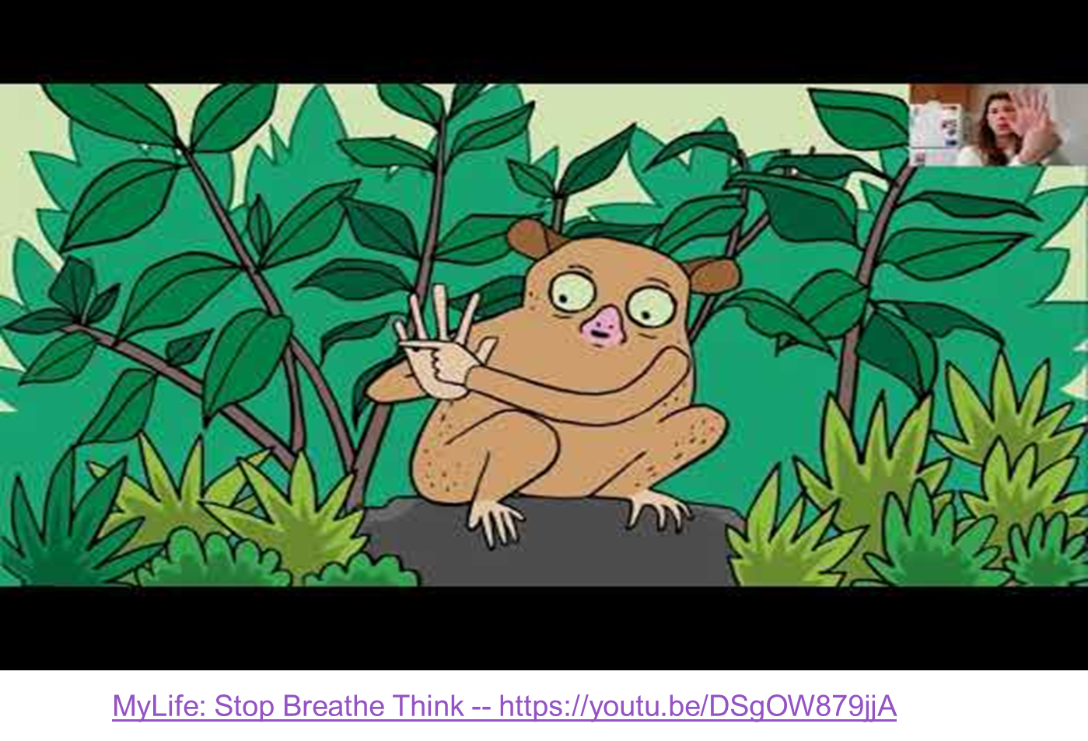
CONTENT: PAUSE & REFLECT CLASS
Notes:
Lisa
If we have time…?

